Slide 1
WGST 100-991: Introduction to Women’s and Gender Studies
Week 2: Wednesday, Sept 12/18
Introduction: Foundations, Basic Concepts

Slide 2

Sex and Gender

Slide 3
Introduction: Definition of Sex
Biological characteristics that are considered significant and distinguishing between males and females including the presence of ovaries or testes and external genitalia.

Slide 4
Introduction: Significance of Sex
What if you had been born a different sex? Think about how your life would be altered. Would you have a different job? Different friends?
What would be the same? Perceptions? Activities? Hairstyle?

Slide 5
Introduction: Biological Determination of Sex?
In fact, a surprisingly large proportion of infants are born with chromosomal or anatomical anomalies that make determination of their sex problematic.
Approximately 4 percent of infants have some sex based anomalies which means they do not fit perfectly into the categories of male or female.
Also, about 17 out of every 1000 newborns can be identified as intersexed (a person whose body combines a mixture of male and female physical markers or reproductive organs)

Slide 6
Introduction: Or Assigned Biological Determination of Sex?
When a situation arises that an infant is defined as intersexed the doctor and families seek to identify the dominant features of the infant and then assign the infant a sex (boy or girl).
In short, human decisions and medical interventions can result in the recreation of the sex of the person.

Slide 7
Introduction: Definition of Gender
A system of social properties within society that constitutes people as different in socially significant ways and organizes relations on the basis of the difference.
Also defined as personality traits and behavior patterns, understood to correlate with sex-based differences.

Slide 8
Introduction: Significance of Gender
There are certain social expectations that come with what sex a person is designated.
These social expectations are taught to us from the beginning of our lives until our end.
Those that meet these expectations are generally accepted, those that do not tend to be sanctioned or punished.

Slide 9
Introduction: Determinants of Gender?
But are these social expectations universal, natural, or even desired?
Or are they simply subjective assumptions of how a person should be or portray themselves?

Slide 10
Introduction: Sex and Gender-The Differences
Look at your face in the mirror. You will see your biological aspects such as bone structure and facial features. These can be attributed to your sex.
You will also see your choice in hair colouring, haircut, makeup, and piercings which may be influenced by societal expectations placed upon men and women.

Slide 11
Introduction: Socialization
Definition: The life-long social learning a person undergoes to become a capable member of society.
Primary Socialization: Learning that takes place in the early years of a person’s life that is crucial to the formation of an individual’s personality.
Secondary Socialization: Learning that occurs after childhood, usually involving learning specific roles, norms, attitudes, or beliefs, and sometimes involving self-imposed learning.
Anticipatory Socialization: Learning about and preparing for future roles, built on accumulated learning.

Slide 12
Introduction: Socialization, The Media Example
As Children and Young Adults:
https://www.youtube.com/watch?v=w2bYinZ6RX0

Slide 13
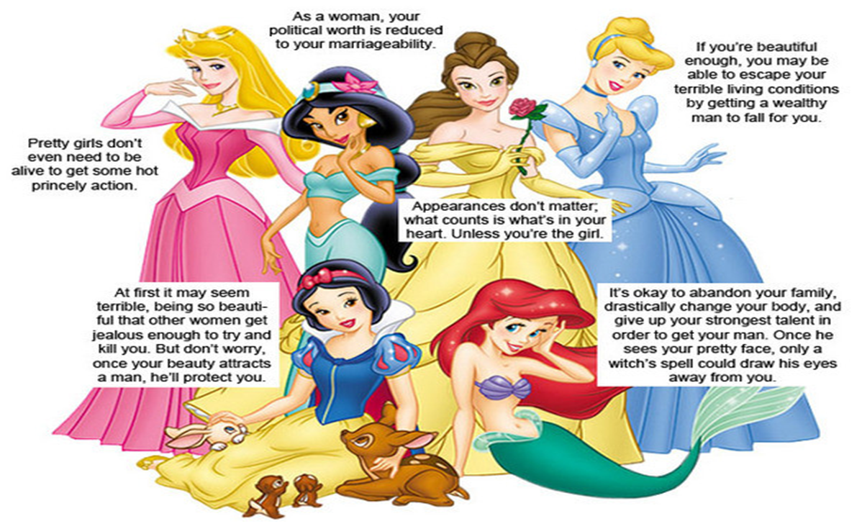
Socialization: The Disney Example

Slide 14
Introduction: Normative Expectations
Normative Expectations: elements that guide our behaviour and assessments of others .
Serves as a tool in which people are ultimately measured in society.
Reinforces the pressure to conform rather than celebrate diversity.
People feel pressure to suppress non-stereotyped activities and characteristics in order to avoid being judged as deviant.

Slide 15
Introduction: Normative Expectations
Gender based normative expectations define cultural standards of masculinity and femininity.
It creates a template on which to assess other people and roles for us to play in order to conform.
Gender roles: a set of behavioural expectations based upon a person’s perceived gender. These roles are thought to influence they ways in which people are supposed to think, feel appear, and behave.
https://www.youtube.com/watch?v=klgeo37QES0
Sex roles: historically accepted idea that men and women behave differently due to their biological capacities in concert with learned behaviour deemed appropriate for their sex.

Slide 16
Stereotypes: the Gender Dichotomy (Top 5 as per research)
Masculinity
Femininity
Tough
Independent
Aggressive
Rational
Competitive
Gentle
Dependent
Passive
Emotional
Co-operative

Slide 17
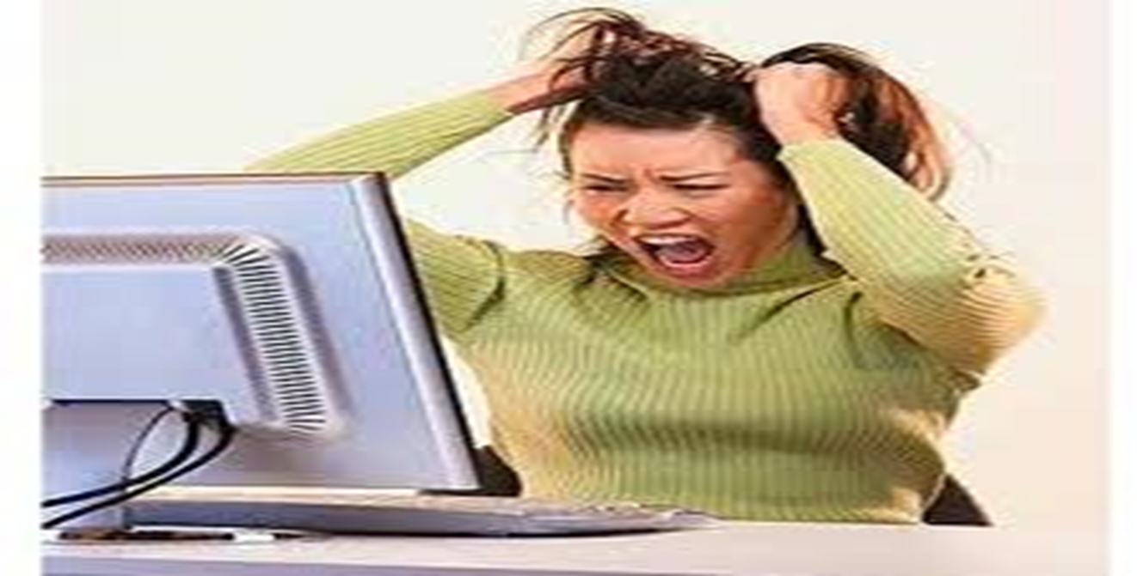
Why Theory???

Slide 18
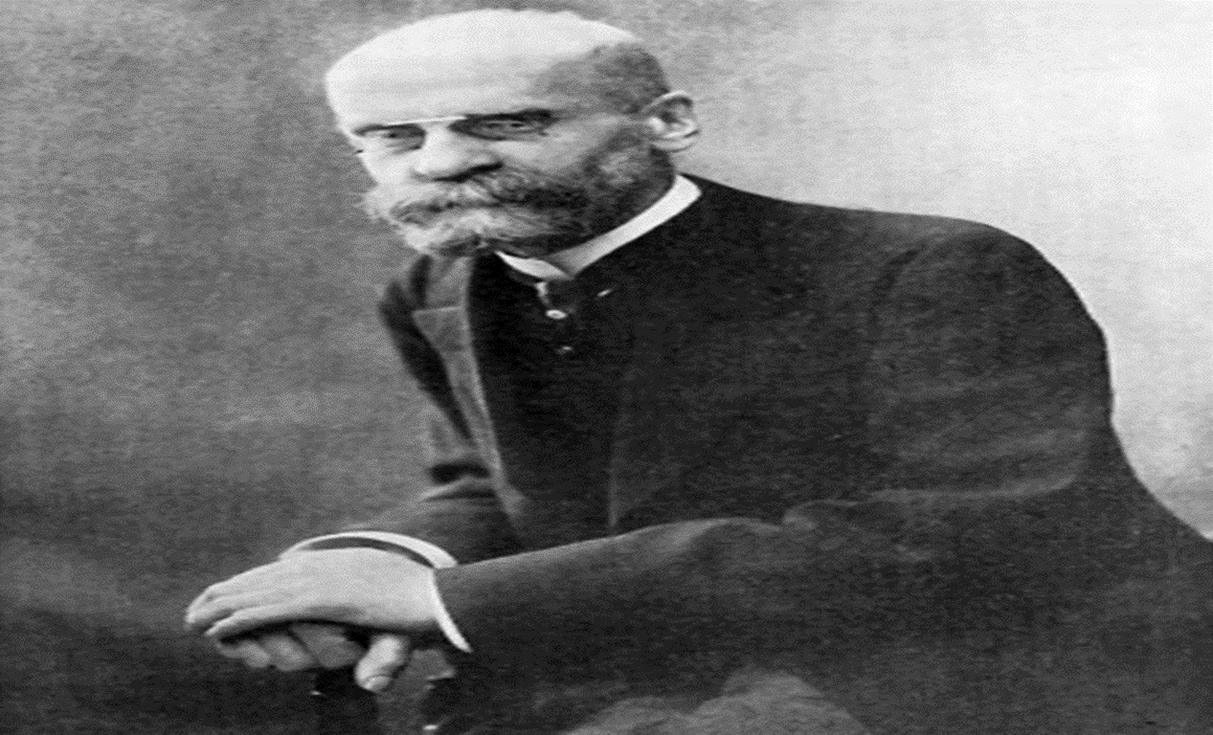
Structural Functionalism

Slide 19
Structural Functionalism-Overview
Views society as a set of interconnected parts that work to preserve the overall stability and efficiency of the whole.
Institutions (family, government, education, media, etc) are the structures that contribute to the continued functioning of society.
All structures have a specific purpose, all are needed to be functioning properly, and all need to be in equilibrium in order for society to thrive.
Key theorists: Emile Durkheim, Talcott Parsons

Slide 20
Structural Functionalism-The Keys
More specifically, all institutional structures perform two key functions.
Manifest Functions: the intended function.
Structures are created and institutionalized for a reason.
They are not accidental.
For example, education is intended to provide students with knowledge, skills, and cultural values that will help them to work effectively in society.

Slide 21
Structural Functionalism-The Keys
Latent Function: unintended and often hidden functions.
Latent functions are just as important as manifest ones but are not part of the original construction and design of a particular structure.
Using education as an example again, it also works in society as a “baby sitter” for young children and teenagers not yet ready to undertake full time jobs, and as a “matchmaker” where older high school and university students can meet and mingle with potential mates.
These functions are not readily admitted to be providing these things (when was the last time a teacher admitted that they are providing daycare service) but they are very real.
https://www.youtube.com/watch?v=BKl6HSnlaIk

Slide 22
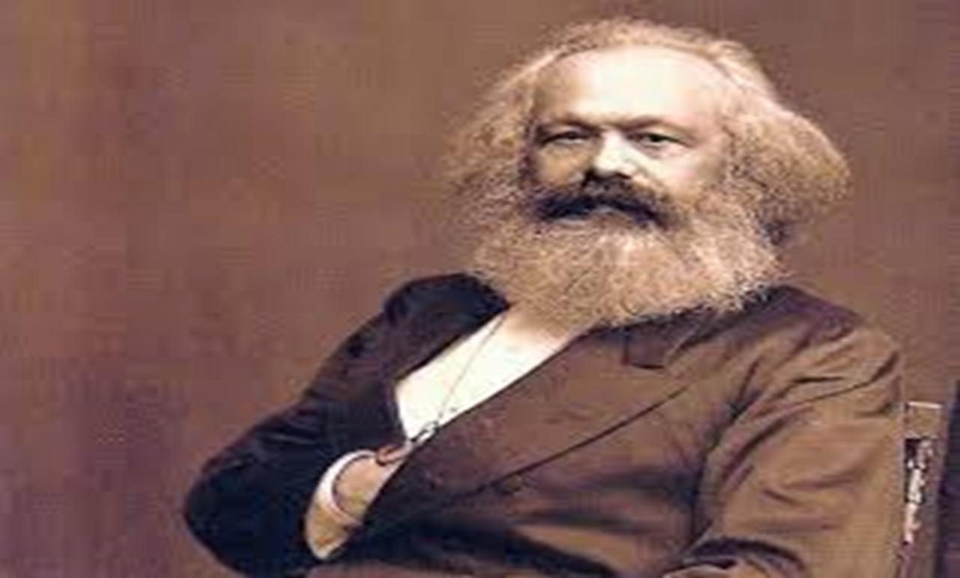
Critical Theory

Slide 23
Critical Theory-Overview
Also called Conflict theory.
Critical theory arises out of the basic presumption that there exists in society a basic division between the “haves” and the “have nots.”
The term for this is social stratification.
Whether the focus be on themes of class, gender, race, or anything else, there is always the presumption that there exists in every social institution and structure an unequal distribution of power.
In short, it examines the domination by one group over others.
Society, in this view, is a collection of varied groups that constantly struggle with each other to dominate society and its institutions.
There are a number of sub-theories attached to Critical Theory; including Feminist Theory and Post-Modernism

Slide 24
Critical Theory-The Marx Example
Karl Marx-19th century economic and political philosopher.
Unlike structural-functionalists, Marx viewed modern social problems not in terms of structures that have become unhealthy but on the actual structure itself.
He asserted that an exploitative economic system was to blame.
In any capitalist society two broad economic groups (or classes) will emerge: the Capitalists (or “haves”) which are the elite owners of the means of production, and the workers (“have nots”) who are forced to sell their labour in exchange for a liveable wage.
As the social class that controls the economic system, the Capitalists use this great economic and political influence to ensure they remain dominant.

Slide 25
Critical Theory-The Weber Example
Max Weber-late 19th to early 20th century sociologist, economist, and philosopher.
Weber expanded the approach used by Marx, surmising that conflict is not simply restricted to economic classes alone or to capitalism.
He included conflicts that arise over cultural values, social status, and issues of personal honour.
Weber suggested that we see conflict in almost every institution or structure in any large society with status groups, classes, political parties, and even gender.
From this point of view, even a modern corporation, with multiple owners and managers, experiences internal conflict between sub-groups.
Out of the works or Marx and Weber comes modern Critical Theory and the Frankfurt School of Sociology.

Slide 26

Symbolic Interactionism

Slide 27
Symbolic Interactionism-Overview
Focuses on the actions and interactions between small groups of people.
Daily interaction and how through language and symbols we both grow and maintain our social groups.
Unlike previous theories this one does not paint broad strokes on the nature of society and, thus, is labeled a “micro-theory.”

Slide 28
Symbolic Interactionism-Basic Principles
Human beings have a great capacity for personal thought which differentiates us from lower animals.
This greater capacity allows us more complex relationships and the ability to form dense layers of social groups based on shared meanings of symbols, language, and gestures.
These symbols et al are not static but can and often do change over time to fit the growing needs and desires of those within the group.

Slide 29
Symbolic Interactionism-Basic Principles
On a more individual level we can modify these things as well.
This is the great gift of independent thought.
Although we are brought up to believe and think in a certain way, ultimately it is up to us as individuals to actually do so in our lives.
We are not slaves to our past, upbringing, or habits but free to choose and think as we wish.
Overall, this is seen as the basis for all things in the social world.

Slide 30
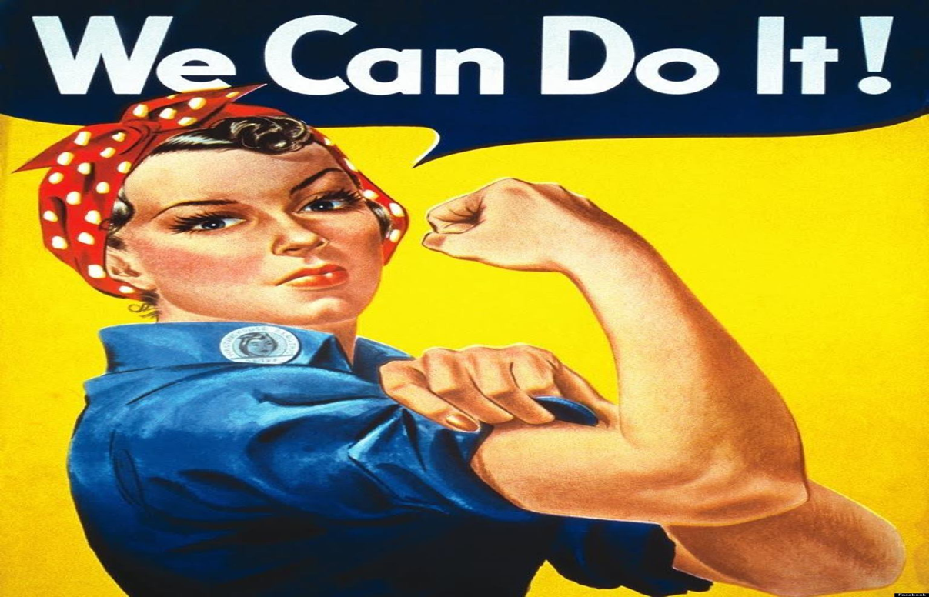
Feminist Theory

Slide 31
Feminist Theory
Subset of Critical Theory
Patriarchy: the hierarchical organization of society, with males dominating most of the positions of power and wealth, while a disproportionate number of females fill subordinate positions with little wealth or control.

